Slide 1
Current-Voltage Relationships

Slide 2
Power and Energy

Slide 3
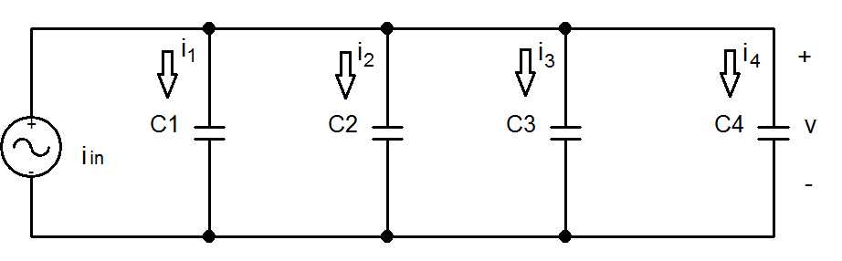
Capacitors in Parallel

Slide 4
C_{eq} for Capacitors in Parallel

Slide 5
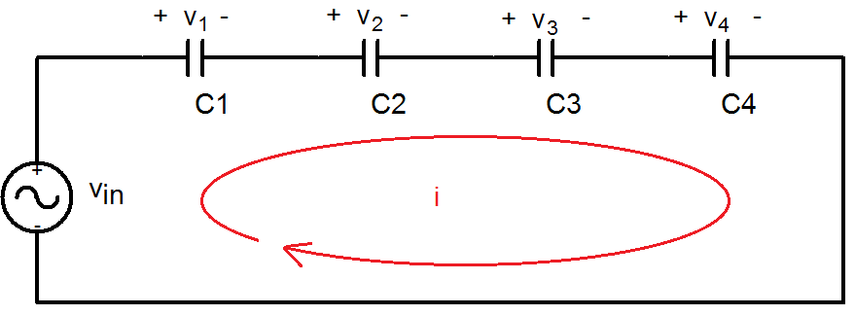
Capacitors in Series

Slide 6
C_{eq} for Capacitors in Series

Slide 7
General Equations for C_{eq}
Parallel Combination
Series Combination
If P capacitors are in parallel, then
If S capacitors are in series, then:

Slide 8
Summary
Capacitors are energy storage devices.
An ideal capacitor act like an open circuit at steady state when a DC voltage or current has been applied.
The voltage across a capacitor must be a continuous function; the current flowing through a capacitor can be discontinuous.

Slide 9
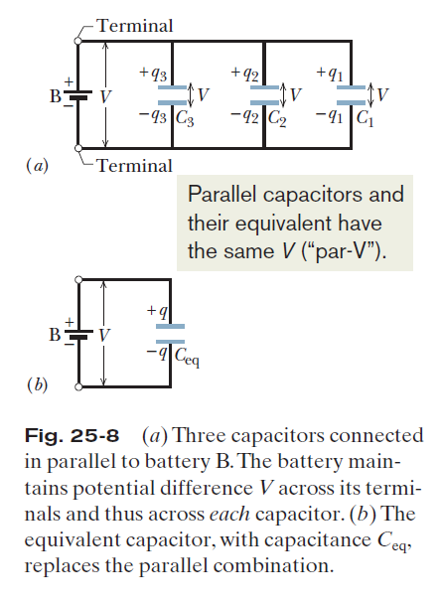



25.4: Capacitors in Parallel:

Slide 10
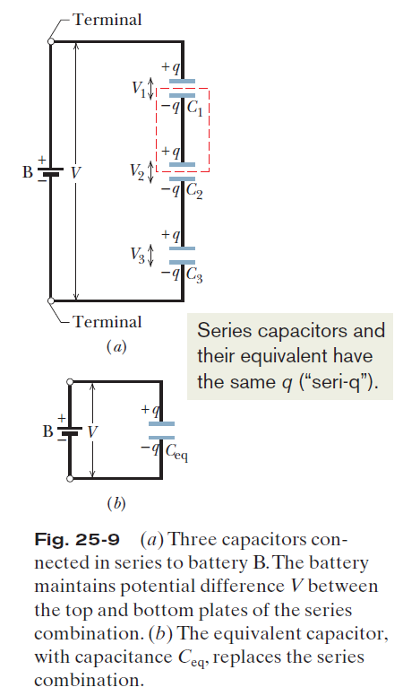





25.4: Capacitors in Series:

Slide 11
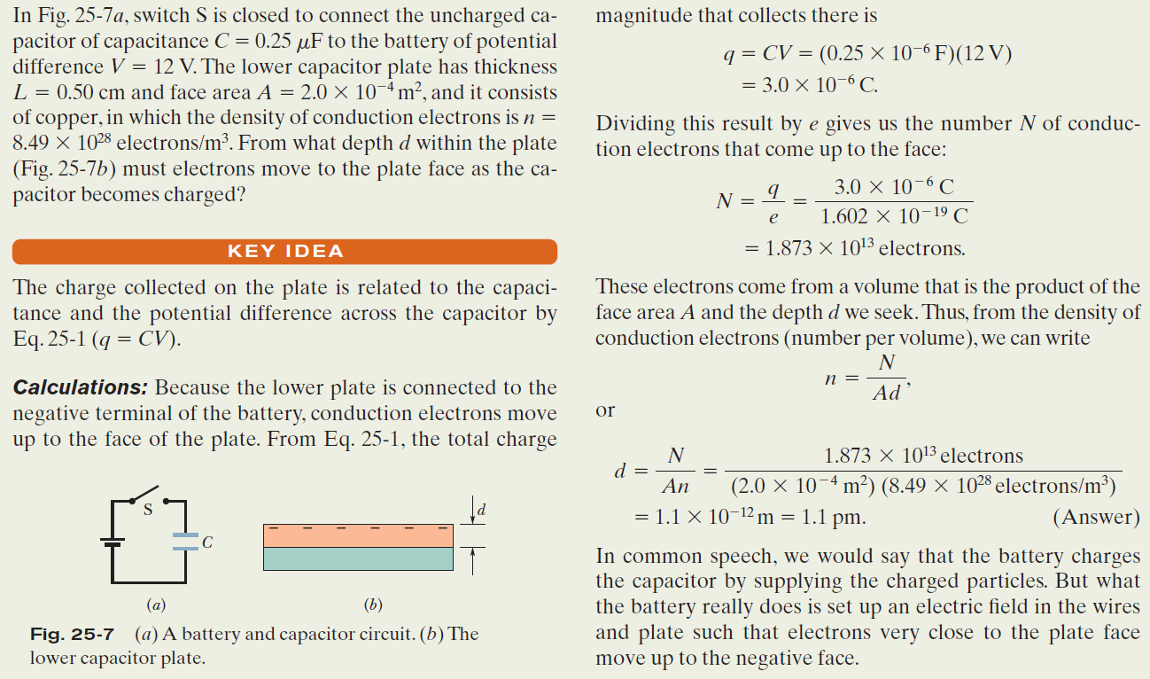
Example, Charging the Plates in a Parallel-Plate Capacitor:

Slide 12
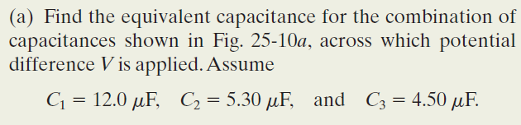
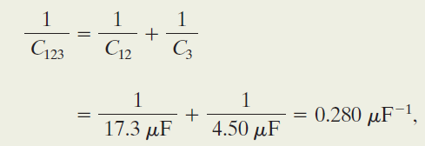

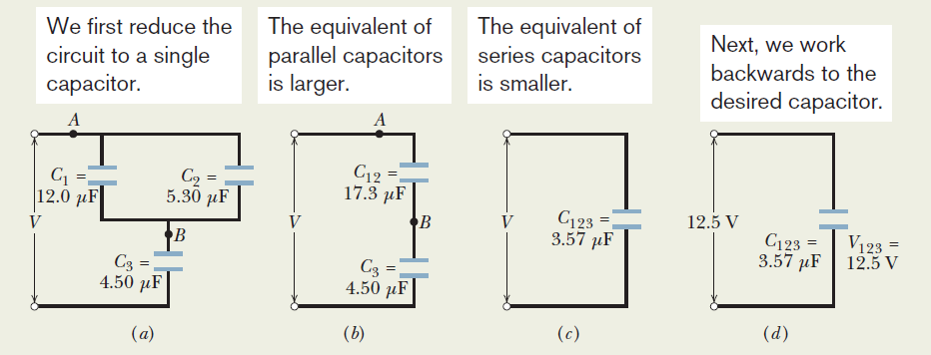

Example, Capacitors in Parallel and in Series:

Slide 13

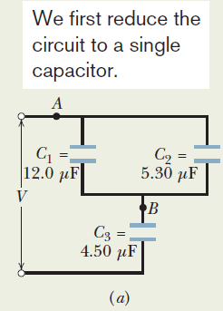
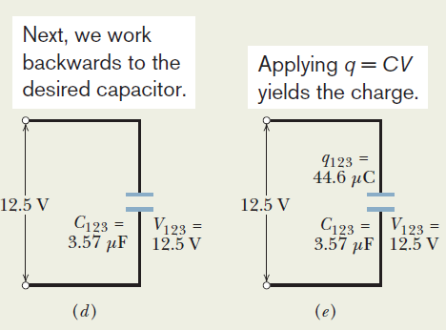


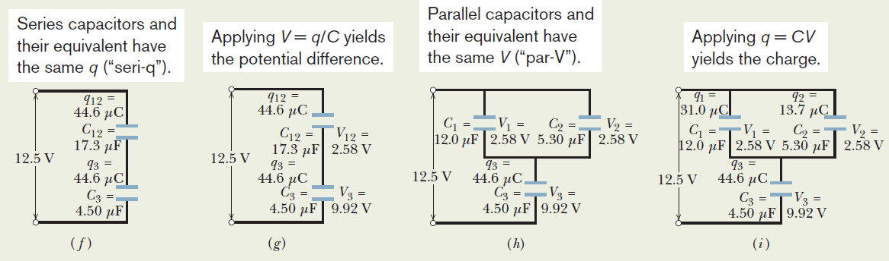
Example, Capacitors in Parallel and in Series:

Slide 14




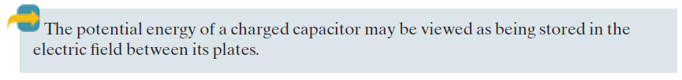
25.5: Energy Stored in an Electric Field:

Slide 15



25.5: Energy Density:

Slide 16
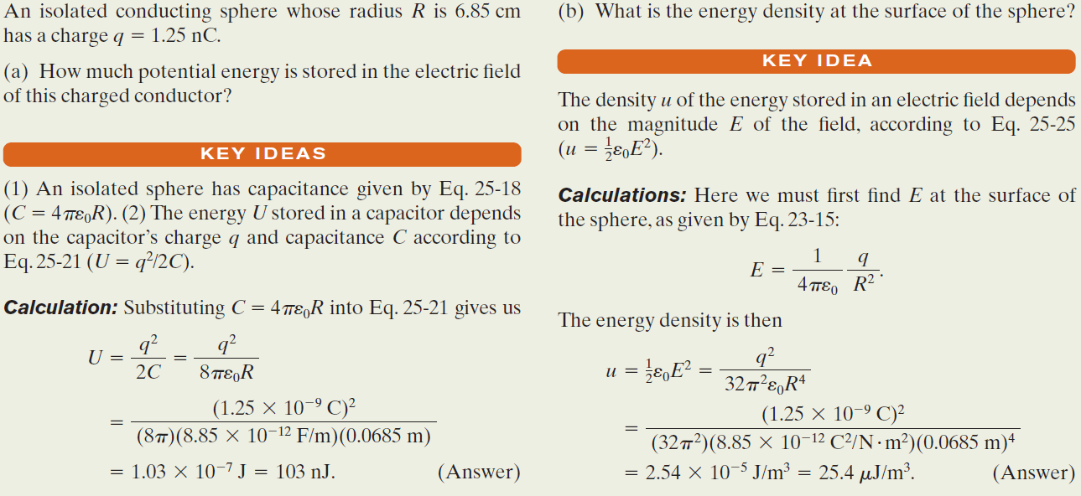
Example, Potential Energy and Energy Density of an Electric Field:

Slide 17
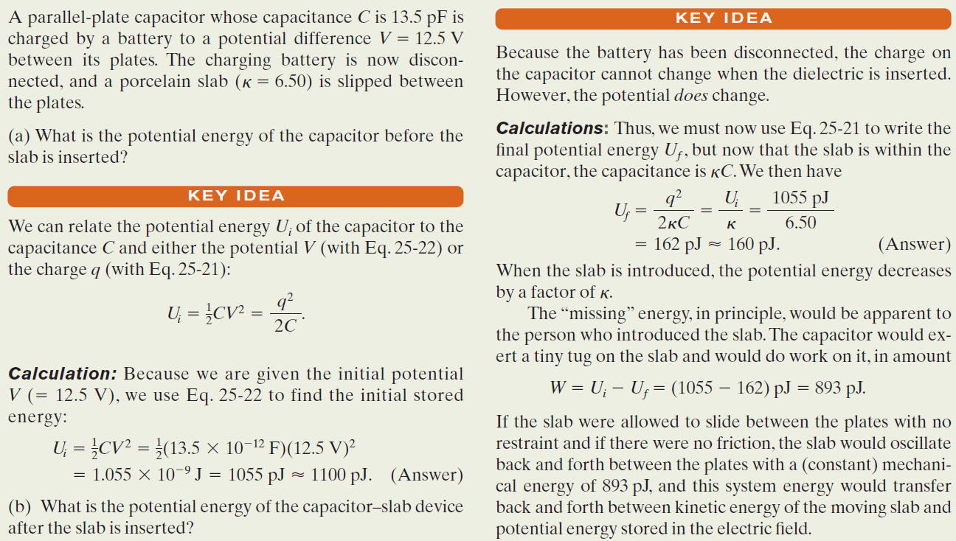
Example, Work and Energy when a Dielectric is inserted inside a Capacitor:

